Slide 1

Teammates web app Software test
Haider

Slide 2
About Teammates web app
It is a feedback management tool for education.
Manage peer evaluations and feedback paths of students
It is provided as a cloud based service for educator students and is currently used by hundred of universities across the world.

Slide 3
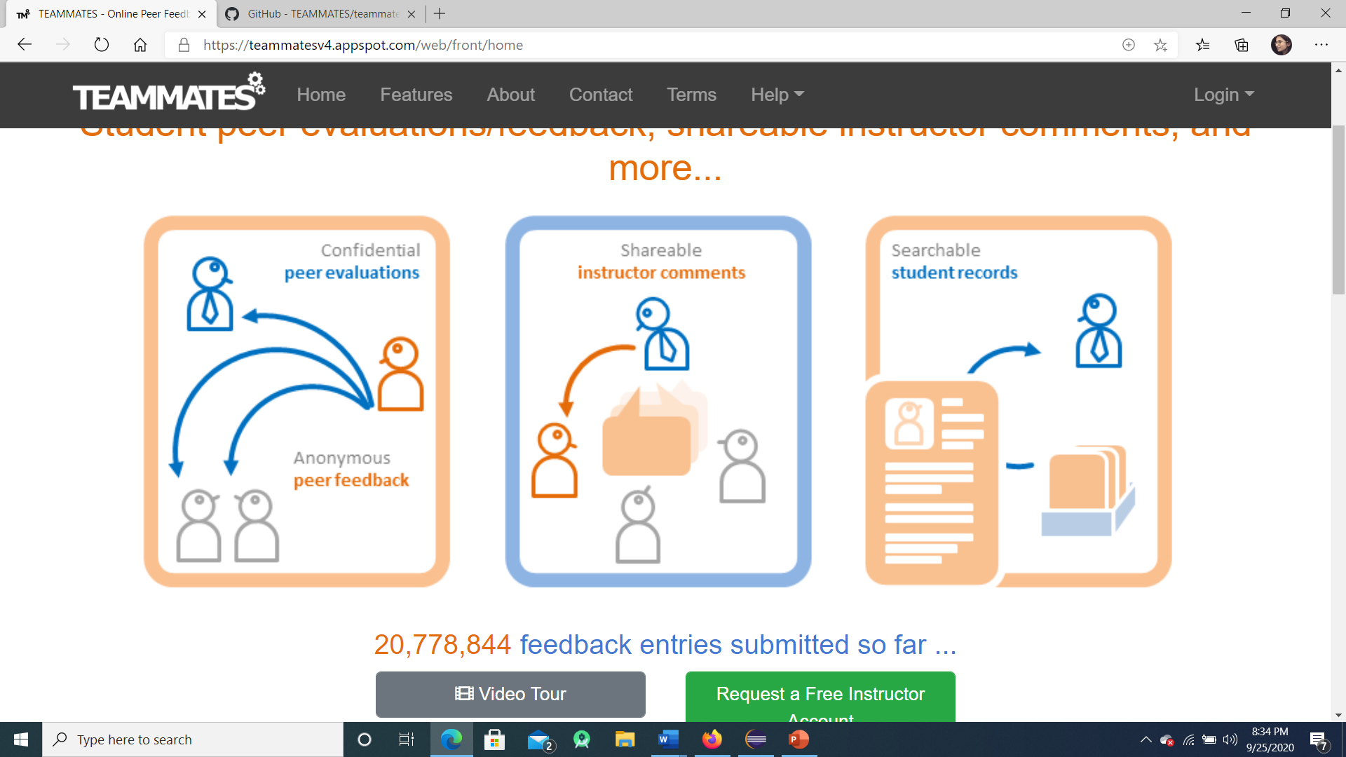

Slide 4
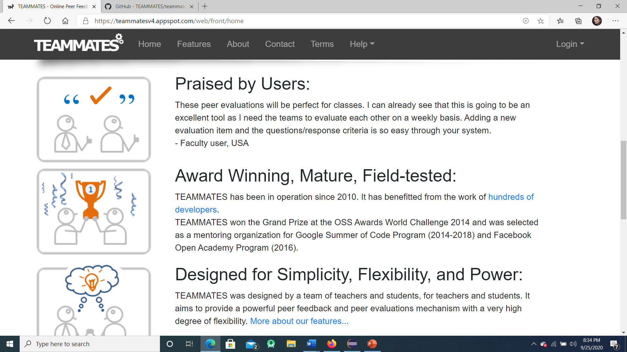

Slide 5
Basic Requirements gathered
Registration/login for the users to have a registered account on teammates.
Features that include visibility, control , Reports and statistics , different question types or reuse past questions.
Feedback option for the instructors and teams.
Basic Functionalities
Confidential Peer Evaluations
Anonymous Peer Feedback
Shareable instructor comments
Searchable student records

Slide 6
Software Testing Approach used
Requirement Id | 002
Requirement Name | Features for user
Description | Different features included in teammates webapp that includes Feedback Visibility Control Reports and Statistics Different question types and reuse past questions
Created On | 22/09/2020
Created By | Haider
We used the blackbox testing approach as well as the whitebox testing in the design document.
The test cases are designed with the requirements gathered in the design document.

Slide 7
Junit Test Cases
TCID | Objective | Prerequisite | Test Data | Test Steps | Expected Result | Actual Result | Status | Remarks
002 | To check all the features | Participant should have a registered account either a student account or an instructor account. | User account data , email and password, feedback for the students | Enter the registered email and password No. of registered participants | w | Login successful | passed | pass

Slide 8
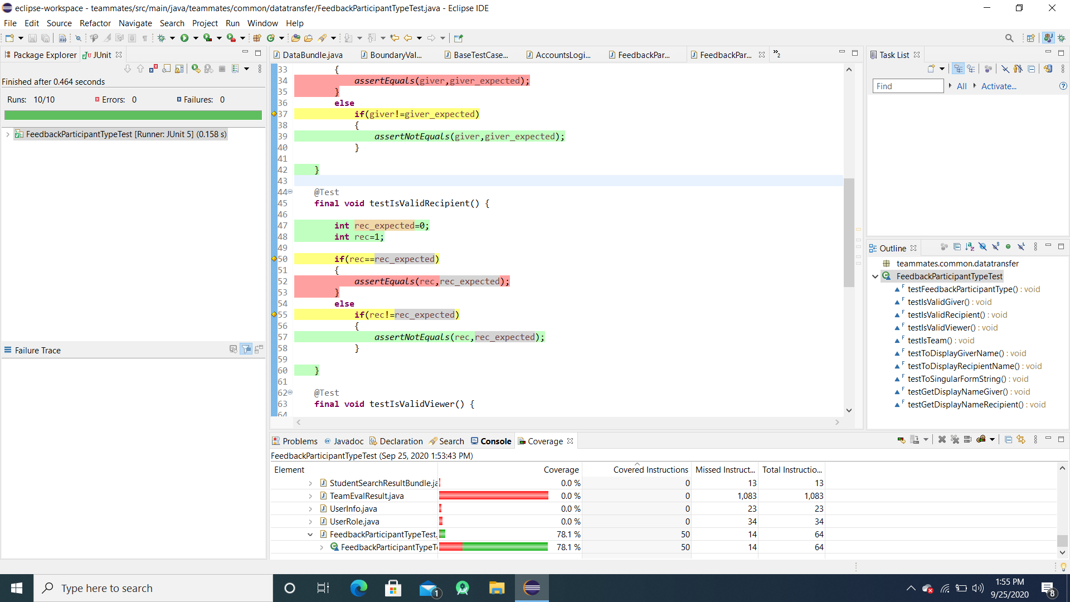
Executed Test Cases with Coverage

Slide 9
Test defect
Defect Id | 005
Summary | Failed login attempt
Severity | high
Detected By | haider
Detected On | 22-09-2020
Status | removed
Priority | high
Linked Test Case | 001
Linked Requirement | 001
Root Cause | Mismatch of password or the wrong password entered by the user.

Slide 10
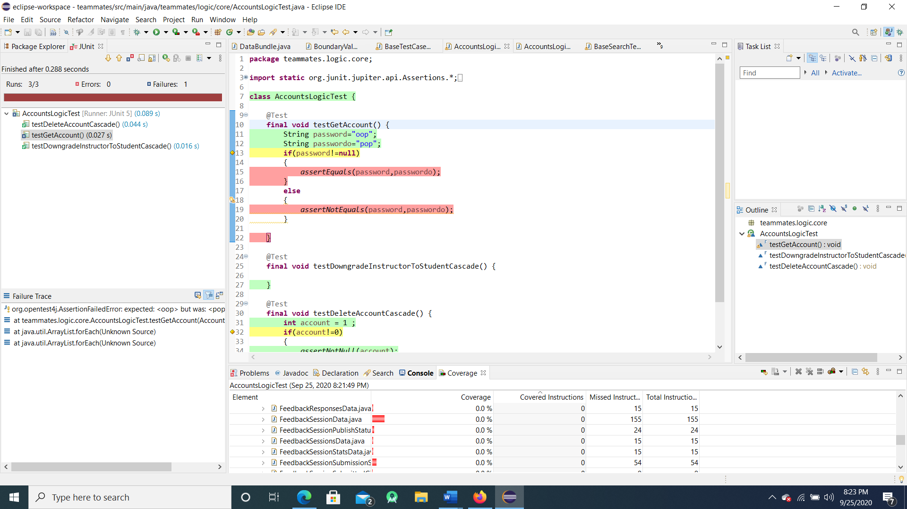
Failure test case with coverage

Slide 11
Challenging part
As the teammates project is so vast that’s why complete testing is impossible however I tested the main functionalities so far.

Slide 12
Thank You

